Slide 1


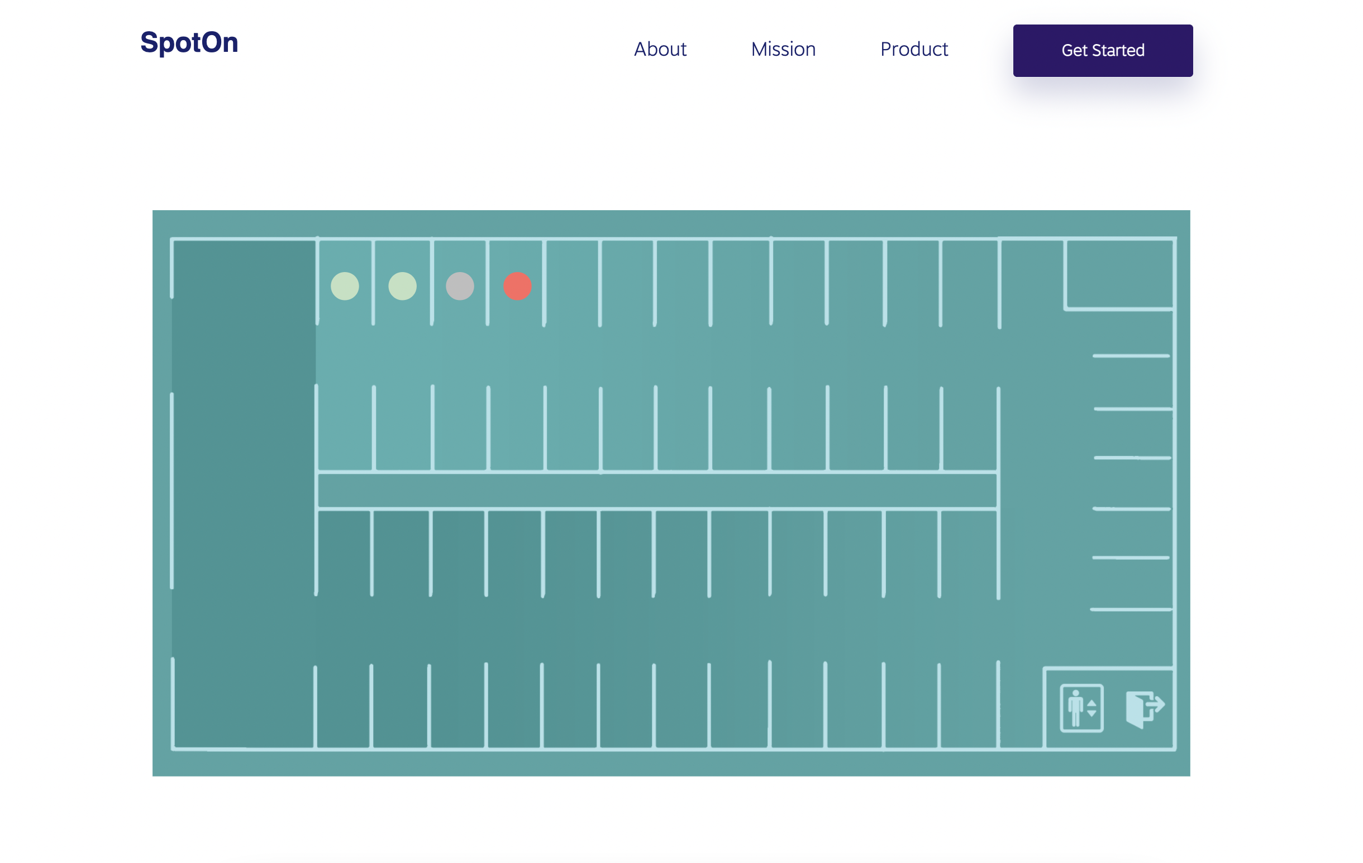
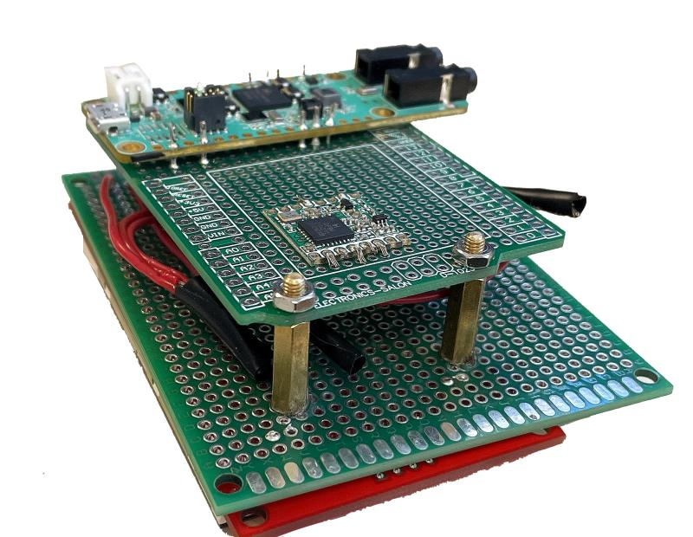
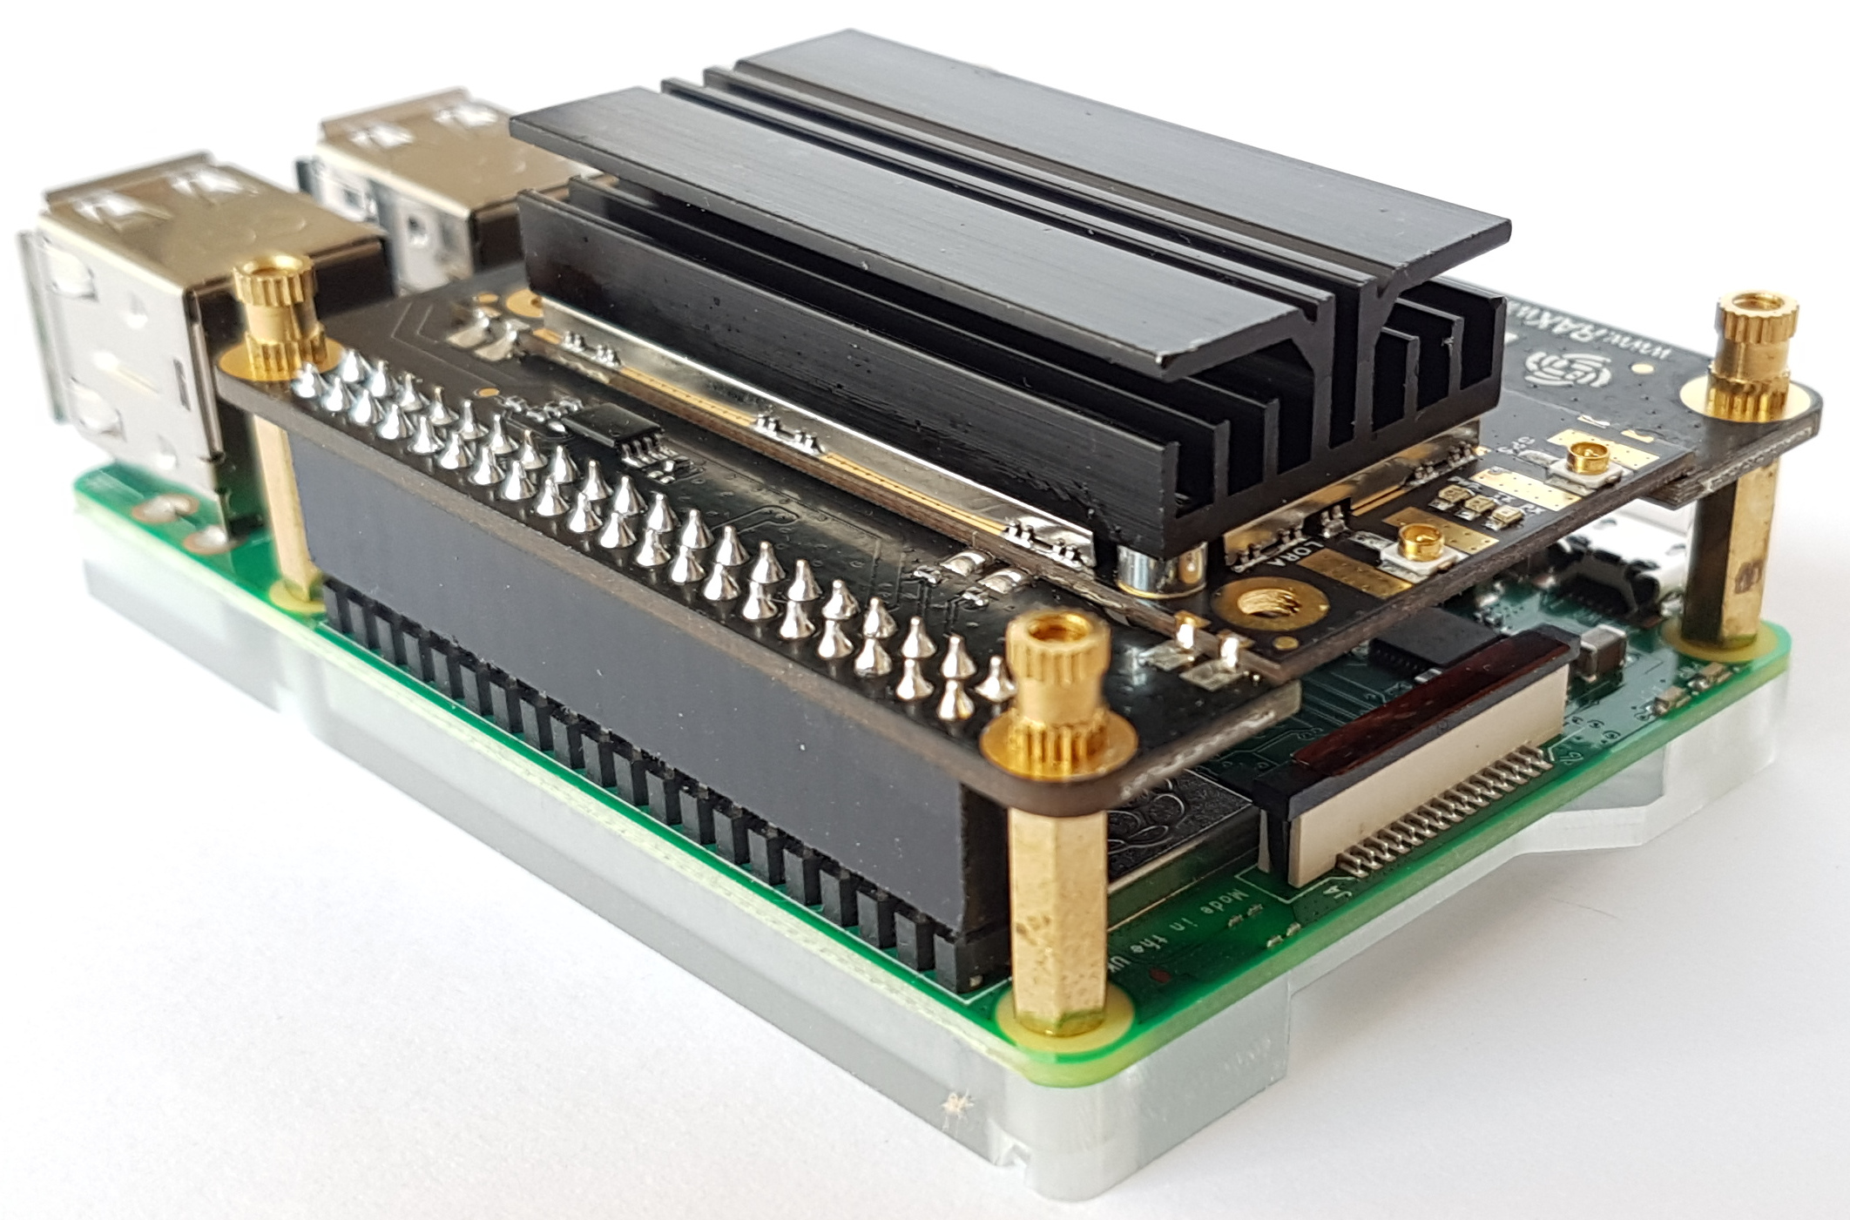
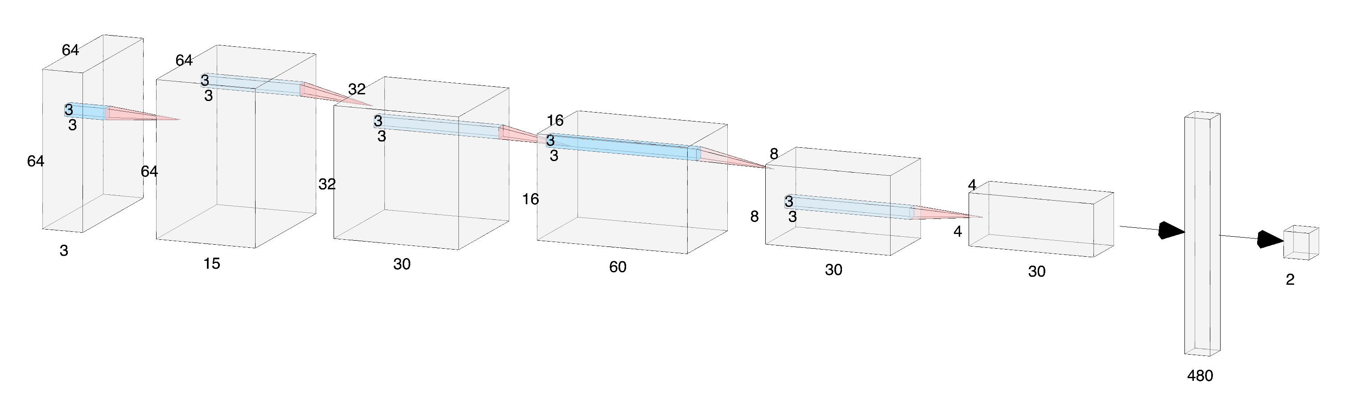
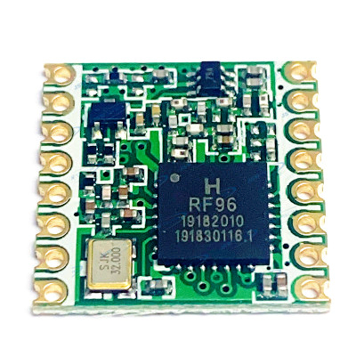
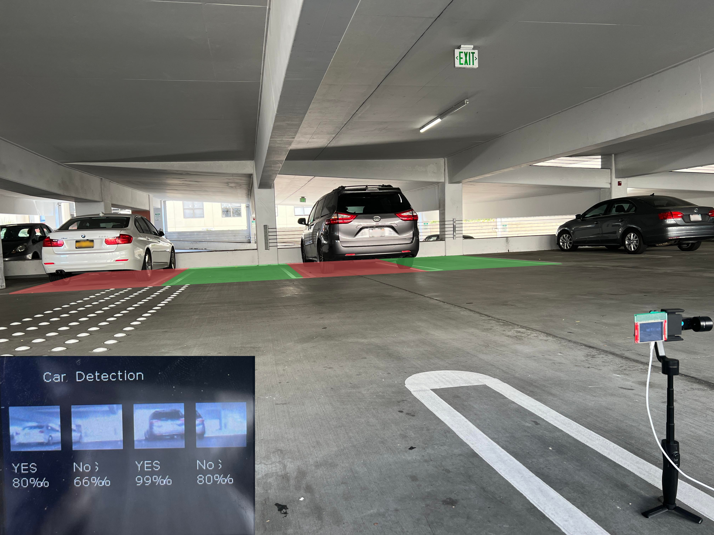
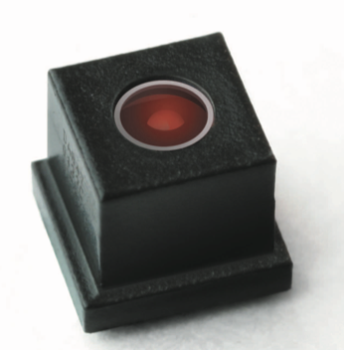
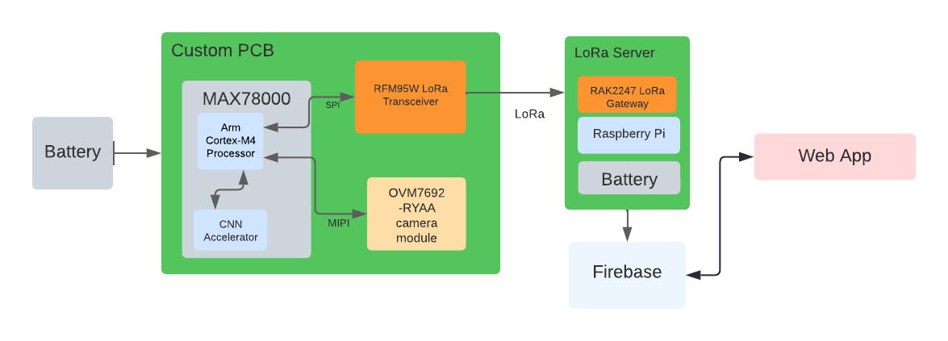
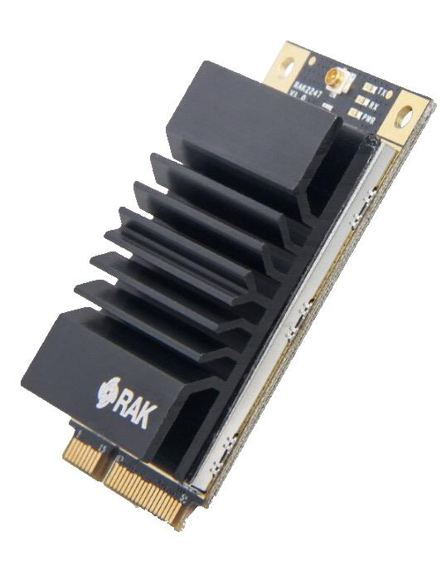
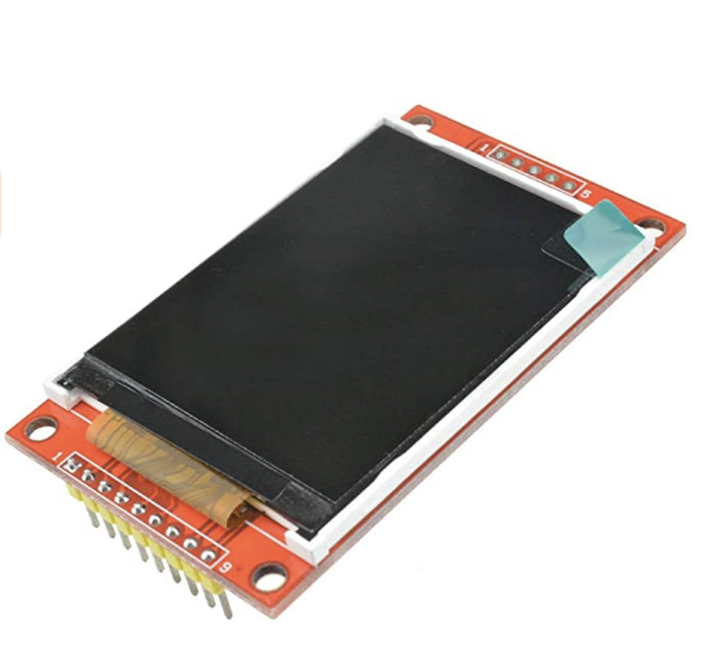
Smart Parking System
Haoming Chen | Kyle Wong | Ian Wu | Isaac-Neil Zanoria | Jiachen Zhang
Background
Final Design
Web App UI
Finding parking spots is a serious issue that wastes every drivers time and money. SpotOn implements a intelligent parking sensor system powered by image recognition. Low cost and low power are ensured due to the on board CNN processing power. After the near real time car detection, all the spots occupancy status will be send to the database through wireless communication and rendered on an web app for the user to check occupancy status of every parking spot.
Vehicle Detection Node
Gateway
Server
CNN Model Architecture
Design Specs
Periodically capture images of parking spaces using an OVM7692 image sensor
Segment and feed captured images to a CNN model capable of detecting vehicles
Send parking availability to central server using LoRaWAN communications
Display parking availability on a react web application for users
Describe key result (consider bullet point list).
Caption and/or text (preferably bullet points)
Hardware / Key Components
MAX78000
Arm® Cortex®-M4
CNN Accelerator
Supports 3.5 million 8-bits weights
RFM95W Transceivers
LoRaTM Modem
168 dB maximum link budget
SPI Interface
Field Test
Block Diagram
OVM7692
1/13-inch optical format
Automatic Exposure/Gain Control
MIPI Interface
RAK2247 LoRaWan Gateway
-139dBM sensitivity
Full LoRaWAN 1.0.2 stack support
SPl interface
Describe key result (consider bullet point list).
ILI9341TFT LCD Display
Resolution: 240x320
SPI Interface
Acknowledgements:
Special Thanks to Yogananda Isukapalli, Brycen Westgarth, Christopher Cheney

